Slide 1
In April 2025, only about 25% of the stop-and-searches lead to arrests highlighting bias

Slide 2






Key findings:
Disproportionate targeting of ethnic and low-income areas
Drug-related reasons dominate searches for some groups
Most searches result in no further action.
Significant amount of missing or incomplete data.
Underreporting may suggest deeper bias.
Notes:
Stop-and-searches are disproportionately targeting ethnic minorities and low-income neighborhoods.
A large percentage of these searches result in no further action, raising concerns about potential bias.
Additionally, underreporting and missing data ( particularly in outcomes and ethnicity fields) may hide further patterns of bias or inconsistencies in policing.

Slide 3
How I found it?
Filtered April 2025 data by ethnicity, age, gender, and outcome
Used bar charts, pie charts, and dynamic card in Power BI
Mapped coordinates to reveal geographic concentration
Compared % of searches vs. population data in Bristol

Slide 4
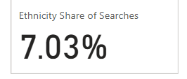
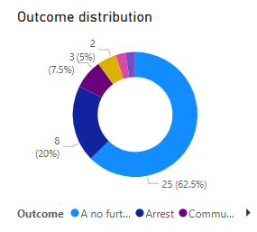
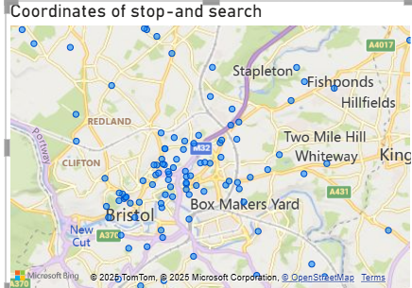
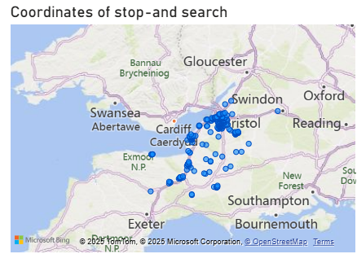
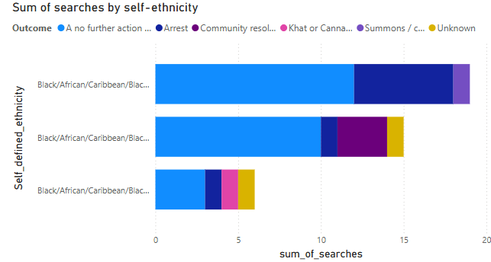
Who Is Being Stopped and Is It Proportional?
Majority of the stop and searches are densely populated in Bristol
Black individuals make up only 5.9% of the population, yet 7.03% of all stop-and-searches.
Map coordinates show clustering in certain low-income neighbourhoods and ethnic neighbourhoods

Slide 5
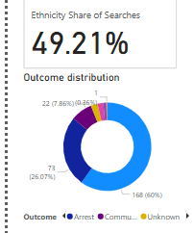
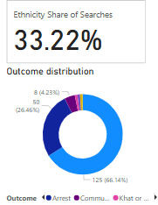
Do Stop-and-Search Outcomes Differ by Ethnicity?
Over 66% of non-white groups searches lead to no further action.
Very few cases to arrests despite higher search rates
White: slightly lower at 60%
Arrest rate higher for White (26%) than Black (20%)
White counter parts outcomes
Non-white groups outcomes
Notes:
The percentage card represents ethnicity of the stop-and-searches. When the filter is selected it filters out and finds the percentage of people selected self-defined ethnicity. This allows to delve more into the data

Slide 6
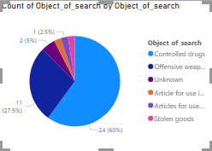
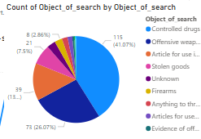
Search Reasons Differ by Ethnicity
Black Individuals
Officers record what they’re searching for, not what’s found.
60% of Black searches were for suspected drug possession
White individuals were stopped for a broader range of reasons.
White individuals
Notes:
The object of search reflects what officers intended to find, not what was actually recovered.
Over 60% of searches involving Black individuals were based on suspicion of drug possession.
In contrast, White individuals were stopped for a wider range of reasons.

Slide 7
Why this is important?
Raises questions about fairness and proportionality in policing.
Impacts trust in communities of the police
Highlights needs in transparency in reporting of this data to the public and within the force itself to address concerns

Slide 8
Should we investigate why ~18% of both ethnicity of the officer and stop-and search person are not recorded?
Notes:
The low arrest rate from April’s stop-and-search activity raises concerns about how effectively the powers are being used see before in the data.
We’ve looked at self-defined ethnicity, but the officer’s perception matters too, especially if it influences decisions to stop someone. With nearly 1 in 5 officer-defined ethnicities not recorded, it’s hard to assess whether certain groups are disproportionately targeted based on perception rather than facts .

